Slide 1


S
Global Automotive Practice Automotive Cyber Security, October 2020

Slide 2

Agenda
Attack Surfaces
Regulations and Standards
Industry Challenges
Software Development Trends Survey
Collaboration
What GENIVI Offers
Automotive Cyber Security
OUR APPROACHES AT A GLANCE

Slide 3
Wireless connectivity in cars many attack surfaces
The cumulative number of cars shipped with embedded cellular connectivity will total 570M vehicles between 2018 and 2027.
Cars with Bluetooth make up an even larger number at 808M, cumulative, shipped vehicles sold between 2018 and 2027.
Cars with Wi-Fi will total 520M cumulative units shipped between 2018 and 2027.
Notes:
Hundreds of millions of wireless attack surfaces. This slide drives home the expansion in the number wireless attack surfaces and shows the need to take security seriously.

Slide 4
Regulations and standards set the stage
On June 25, 2020, the UNECE announced it had formally adopted two new sets of regulations as part of the broader WP.29 regulations. These new regulations include:
UN Regulation on Cybersecurity and Cyber Security Management Systems
UN Regulation on Software Updates and Software Updates Management Systems
In nations that follow these regulations (e.g. EU members, Japan, Republic of Korea, etc.), automakers selling cars for these markets must have certain capabilities in place to monitor, detect, mitigate, and ultimately fix vulnerabilities in cars that malicious actors could compromise.
54 countries are signatories to the 1958 UNECE agreement, and are likely to adopt these regulations at some point in the future, though many plan to do so in the near term.
Key Dates:
These new regulations will apply as of January 2021.
The EU plans to make these regulations mandatory for all new vehicle types from July 2022, and for all new vehicles from July, 2024.
Japan adopted these regulations for SAE Level 3 vehicles in April, 2020, and plans to adopt it for all OTA update-capable vehicles as of November, 2020.
The Republic of Korea plans to implement the regulation at a currently undecided future date.
Other Regulations/Standards/Guidelines:
Standards:
ISO 21434 (Road Vehicles – Cybersecurity Engineering, draft)
ISO 24089 (Software Updates)
SAE J3101 (Hardware Protected Security)
SAE J3061 (Cybersecurity Guidebook for Cyber-Physical Vehicle Systems)
AUTOSAR (Secure On Board Communications)
Other National Legislation/Guidelines:
EU
GDPR
U.S.
NHTSA Cyber Security Guidelines
Proposed legislation (SELF DRIVE Act, AV Start Act)
California - CCPA
China
Cybersecurity Law
Encryption Law (draft)
SAC/TC114/SC34 (related to AV and Intelligent vehicles; has a cyber security working group)
Notes:
WP.29 involves threat analysis, testing, verifying security pre-production, then post-sale involves monitoring, mitigation, and remediation if an attack occurs or if the OEM discoveres a vulnerability.

Slide 5
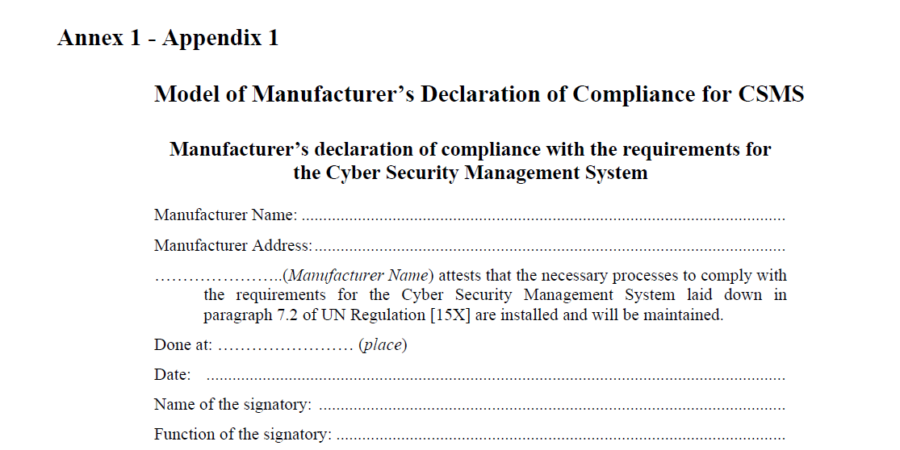


Industry challenges
The automotive industry is facing numerous challenges related to cyber security and must work to implement a range of processes and technologies in a short timeframe.
Compliance: For global OEMs, developing the processes and systems to document compliance with the WP.29 UN Regulation on Cybersecurity and Cyber Security Management Systems is going to be critical over the next few years.
Software Asset Tracking: OEMs must start using systems that provide an inventory of, and monitor, all the software running in each ECU in every deployed vehicle on roads.
Operations: OEMs must either develop or expand the capabilities of internal teams that will be actively monitoring fleets for cyber security threats and analyzing, and fixing (or mitigating) existing vulnerabilities.
Balancing Current and Next-Generation E/E Architecture Requirements: Although some OEMs are able to move to next-gen E/E architectures over the next few years, not all OEMs are moving at the same speed, and many will need to support legacy platforms for years to come. But to comply with regulatory requirements, OEMs MUST secure those legacy platforms, otherwise in many markets they simply won’t be able to sell cars.

Slide 6
Software development trends
The survey: Developed in partnership with Aurora Labs, Strategy Analytics collected survey responses between July 21st and August 10th, 2020. Respondents included professionals working for automakers (22%), Tier 1s (21%), software vendors (15%), semiconductor vendors (15%), industry analysts (13%), and representatives of companies that don’t fall into those categories (“Other.,” 14%). You can download the survey results here.
(Top right) What percentage of vehicle software will be developed in-house by mass-market automotive manufacturers by 2025?
Automaker representative respondents (22%, or 41 individuals) most strongly supported the “Over 25%” category, indicating their intent to do more software development in-house over the next few years.
Total Number of Respondents: 220
(Bottom right) Do you expect this trend to increase over time?
The majority of respondents said they believed this trend would continue.
Total Number of Respondents: 205

Slide 7
Software development trends
How many different suppliers have their code in a high-end vehicle?
Currently, software for high-end vehicles comes from a wide range of sources. The majority of respondents believe (77%) believe that a minimum of 10 different suppliers are providing software for the average high-end car, and 52% of respondents said a minimum of 25 different suppliers are involved. From a cyber security perspective, this means it’s challenging for OEMs to even track what software is in their cars and whether any of that software has existing vulnerabilities.
Total Number of Respondents: 211

Slide 8
Software development trends
When do you expect more than 1 million vehicles per year, across the globe, to be produced with more powerful domain controller-based E/E architectures?
Automotive OEM respondents were the most polarized in their respondents, reflecting that some plan to move very quickly whereas others plan to use legacy platforms for a number of years to come. 52% of respondents believe that the shift will occur for 2027-MY vehicles or later.
Total Number of Respondents: 209

Slide 9
Software development trends
In your opinion, what is the most important for vehicle manufacturers with regard to OTA updates?
The largest group of respondents said “security” for OTA was the most important to OEMs, though safety (at 26%) was a close second. Since safety and security, in this case, are closely linked, these responses indicate that the industry believes it is focused on reducing the potential for problems to occur, either those caused by bad actors or those caused by poor design decisions, mistakes, and process-related issues.
Total Number of Respondents: 193

Slide 10
Software development trends
Do you think the newly adopted regulation on Software Update Management Systems (UNECE WP.29) will accelerate the deployment of OTA updates beyond the infotainment system?
The survey was global, and since the regulations won’t apply in every region, there’s no surprise that a percentage were not aware of the new WP.29 regulations related to OTA updates. Of those who were aware, the more than double (at 40% of respondents) said they thought having regulations would speed up deployment.
Total Number of Respondents: 190

Slide 11


Collaboration
Challenges
Regulations, e.g. UNECE WP.29, will require companies to collaborate more than ever before to find, mitigate or fix vulnerabilities that could expose vehicle systems to cyber attacks.
Fewer vehicles are selling due to COVID 19 and the current economic downturn (though sales forecasts for 2021 show improvements in sales volumes)
The need to shift to EV powertrains and move forward with autonomous vehicle technologies.
Managing vehicle connectivity on a large-scale basis, including large, fleet-wide OTA updates.
What is GENIVI doing to help the industry meet these challenges?
GENIVI provides the opportunity to collaborate, specifically with the goal of helping to create tools and solutions that companies can implement.
“GENIVI doesn't want to just create best practices and standards if nobody uses them. We'll do the hard work, [companies in the industry] need to implement them.”
The GENIVI Security Team is open to industry professionals from across the industry, and is one of the GENIVI groups that doesn’t require participants to be GENIVI members.
One example project is OpenXSAM, which is a data output scheme for threats and events and is working towards compliance for ISO21434 and UNECE WP.29 requirements. Project partners include GENIVI Security Team, Automotive Security Research Group (ASRG), Block Harbor Cyber Security, SecForCars, and itemis’ Security Analysis Team.

Slide 12

Current Team Lead : Joby Jester -- joby.jester@irdeto.com
Focused on Actionable Automotive Security Through Industry Collaboration.
How We’re Different:
Supported by a Diverse Group of Experts, We Tackle the Day-to-Day Security Concerns of the Industry. Inside and Outside of the Vehicle.
We Use Thought Leadership to Bring Digested Information and Updates on the Ever-Growing Complexity of the Automotive Security Space
Reasons to Join:
Friendly, Accepting Networking Environment
Ability to Work on Content and/or Speaking Opportunities
Build Portfolio of Knowledge from Working With Experts
For Links to all Past Content and Meeting Notices : https://at.projects.genivi.org/wiki/
Please Subscribe to The Security Team Mailing List: https://lists.genivi.org/

